Slide 1
Tables. HTML forms.
EXERCISE 3

Slide 2
Tables – basic elements
<table> </table> - table container;
<tr> </tr> - table row;
<th> </th> - header cell;
<td> </td> - data cell.

Slide 3
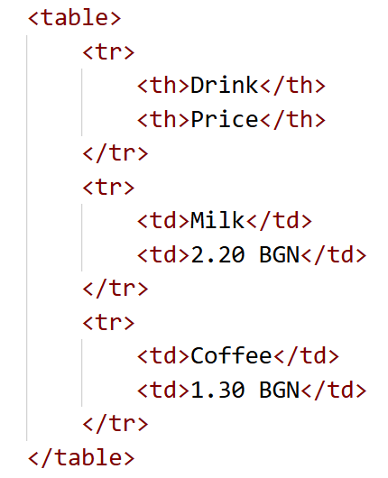
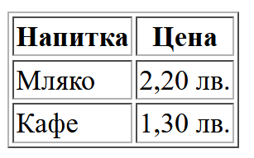
Table

Slide 4
Tables – semantic elements
<caption> </caption> - defines a table caption;
<thead> </thead> - groups the header content;
<tfoot> </tfoot> - groups the footer content;
<tbody> </tbody> - groups the table content.

Slide 5
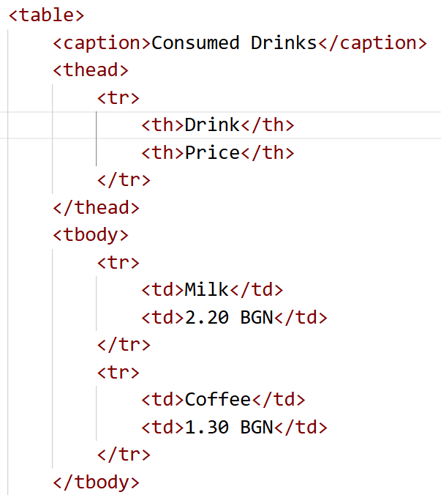
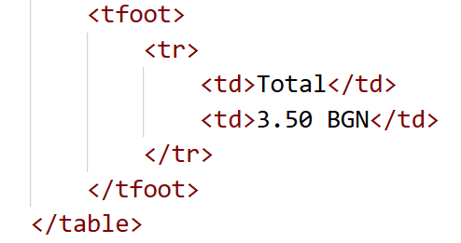
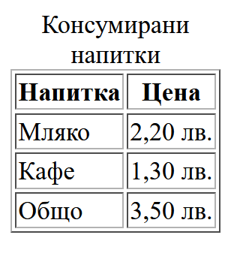
Table

Slide 6
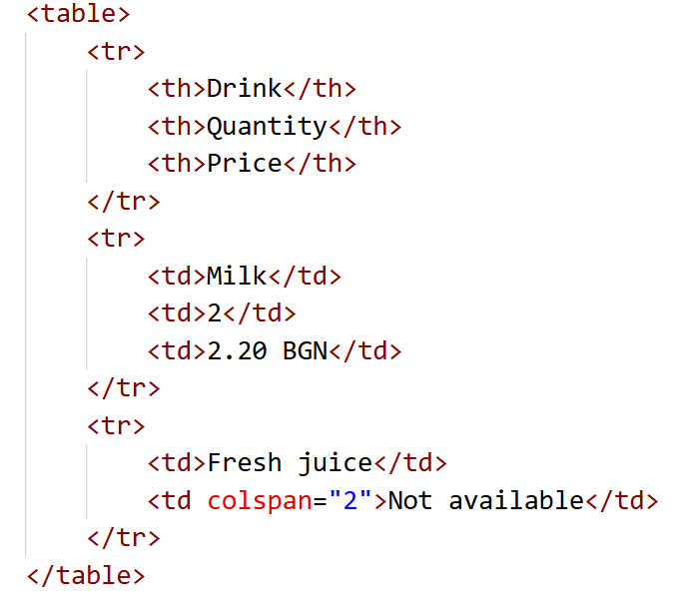
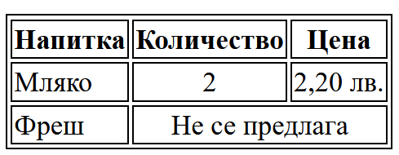
Таблици – colspan и rowspan

Slide 7
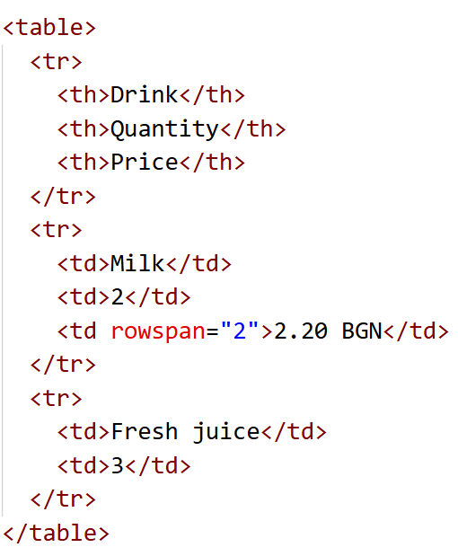
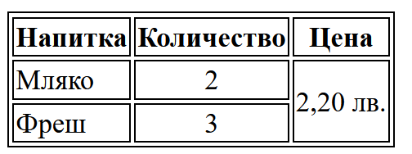
Таблици – colspan и rowspan

Slide 8
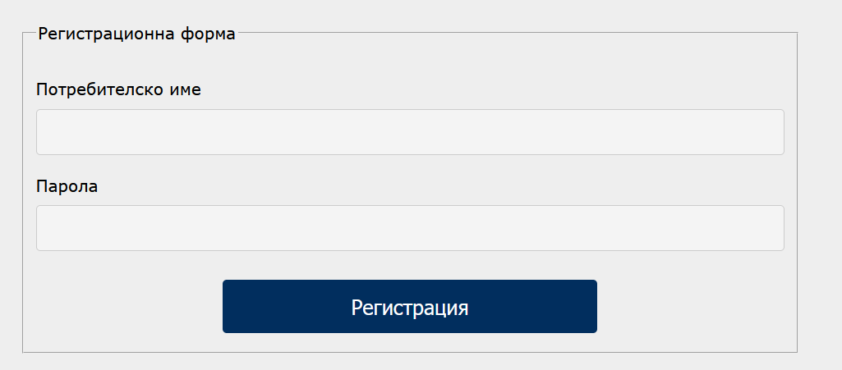
HTML forms
They allow for user data input, which is sent to the server for processing.

Slide 9
Element <form>
<form action="php/action.php" method="post">
……
</form>

Slide 10
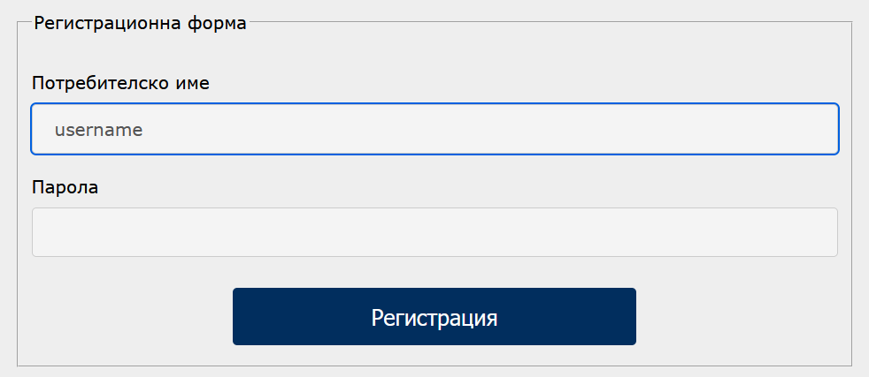
HTML form elements
<input type="text" name="somename“ value=“somevalue”/>

Slide 11
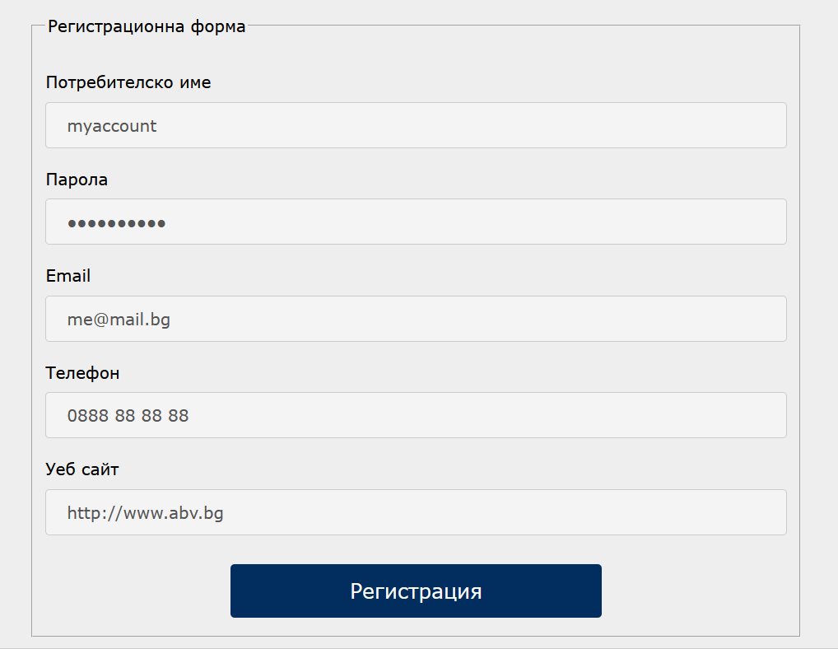
<input type=“…“ />
text
password
email
tel
url

Slide 12
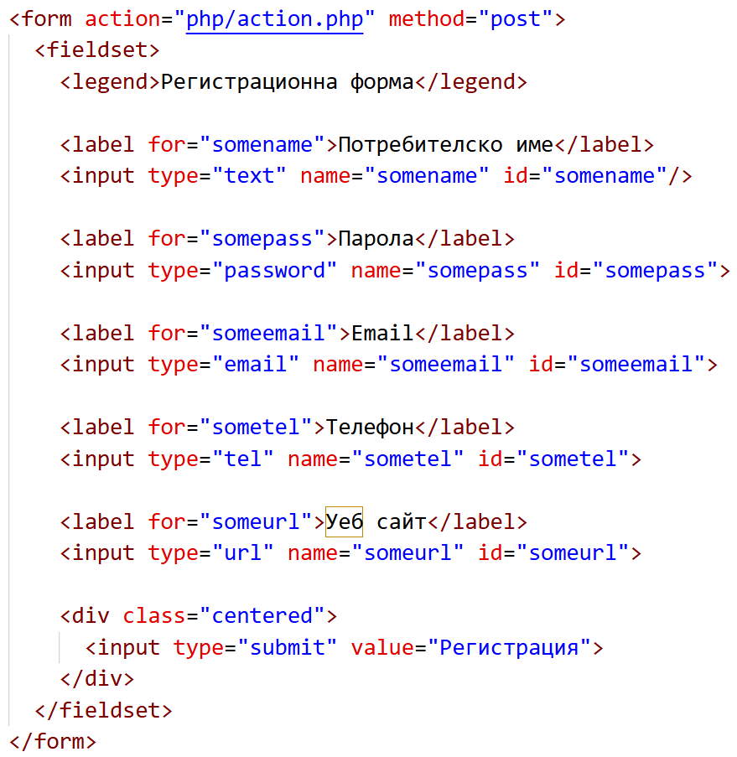
<input type=“…“ />

Slide 13
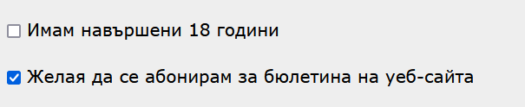
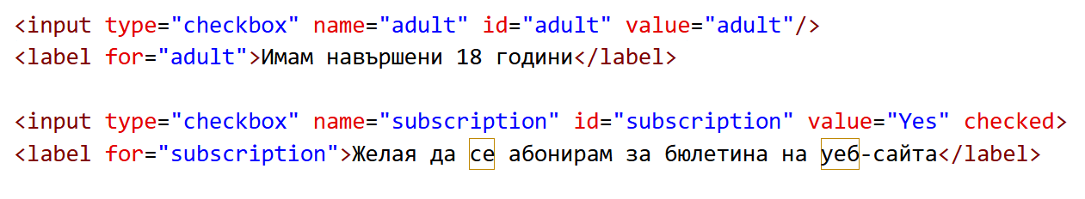
Checkbox

Slide 14
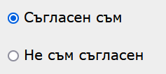
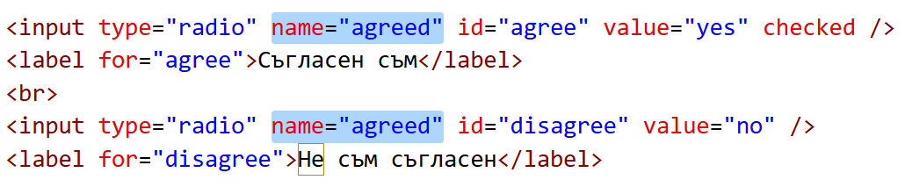
Radio button

Slide 15

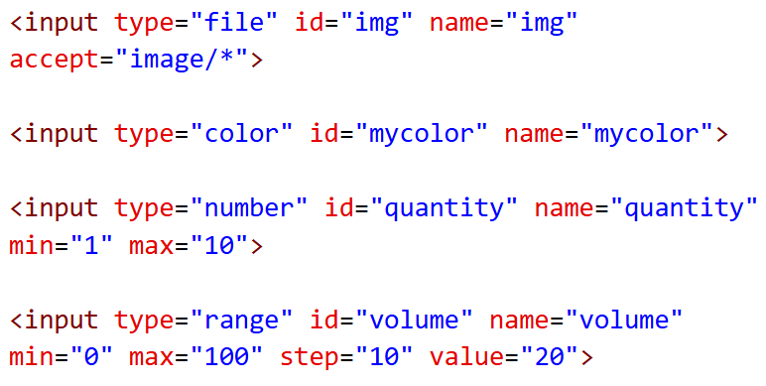

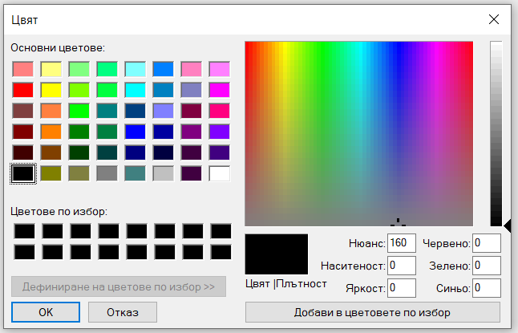


<input type=“…“ />

Slide 16
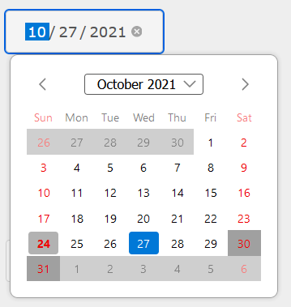
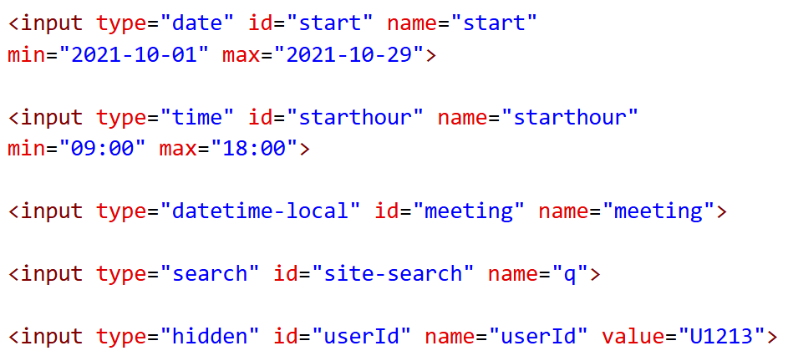



<input type=“…“ />

Slide 17

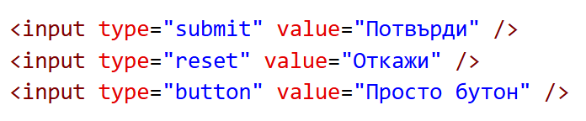
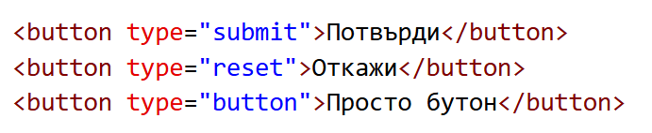
Бутони

Slide 18
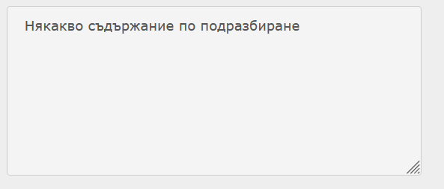
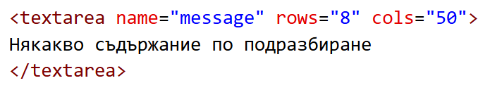
Textarea

Slide 19
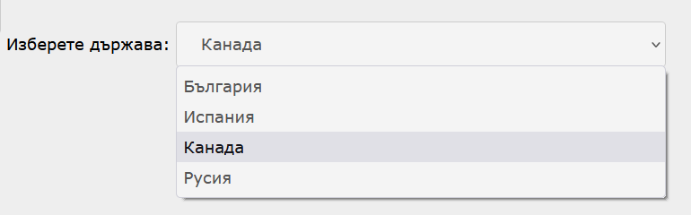
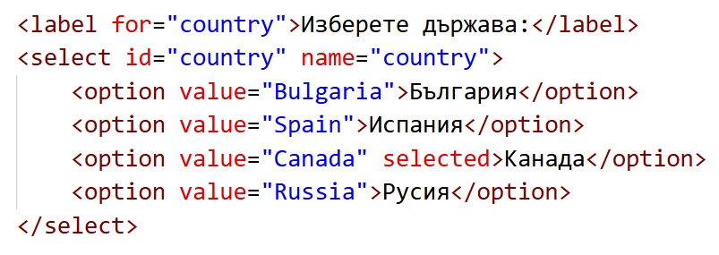
Select

Slide 20
Label

Slide 21
Fieldset – a container for related elements within a form

Slide 22
Attributes – inputs
action
method
enctype
<form action="upload.php" method="post" enctype="multipart/form-data">
autocomplete

Slide 23



Attributes – inputs
value – default value;
for checkboxes and radio buttons – the value sent when an option is selected;
<input type="text" name="somename" id="somename" value="donika“ />
placeholder – contains a hint for the user (not a default value!!!)
<input type="text" name="somename" id="somename" placeholder="Моля, въведете потребителско име"/>

Slide 24

Attributes – inputs
readonly – does not allow the modification of the field's preset values. The field's value is sent when the form is submitted!
<input type="text" name="somename" id="somename" value="donika" readonly />
disabled - The field is inactive and unusable. Its value is NOT sent when the form is submitted!
<input type="text" name="somename" id="somename" value="donika" disabled />

Slide 25
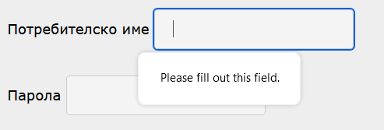
Attributes – inputs
required – prevents form submission if the field is not filled in
<input type="text" name="somename" id="somename" required />
maxlength=“50”, minlength=“5” – maximum / minimum number of entered characters
max=“10”, min=“1” - maximum / minimum accepted value

